Slide 1
The Developing World’s Bulging (but Vulnerable) “Middle Class”
Martin Ravallion

Slide 2
Introduction
Who do financial crisis and economic contractions affect the most? Not the poorest but the middle class.
Determine how many people might be vulnerable to even small income losses.
The term “middle-class” is defined differently in different countries at different levels of economic development.
Based on the US standard, many people in developing countries living below the poverty line.

Slide 3
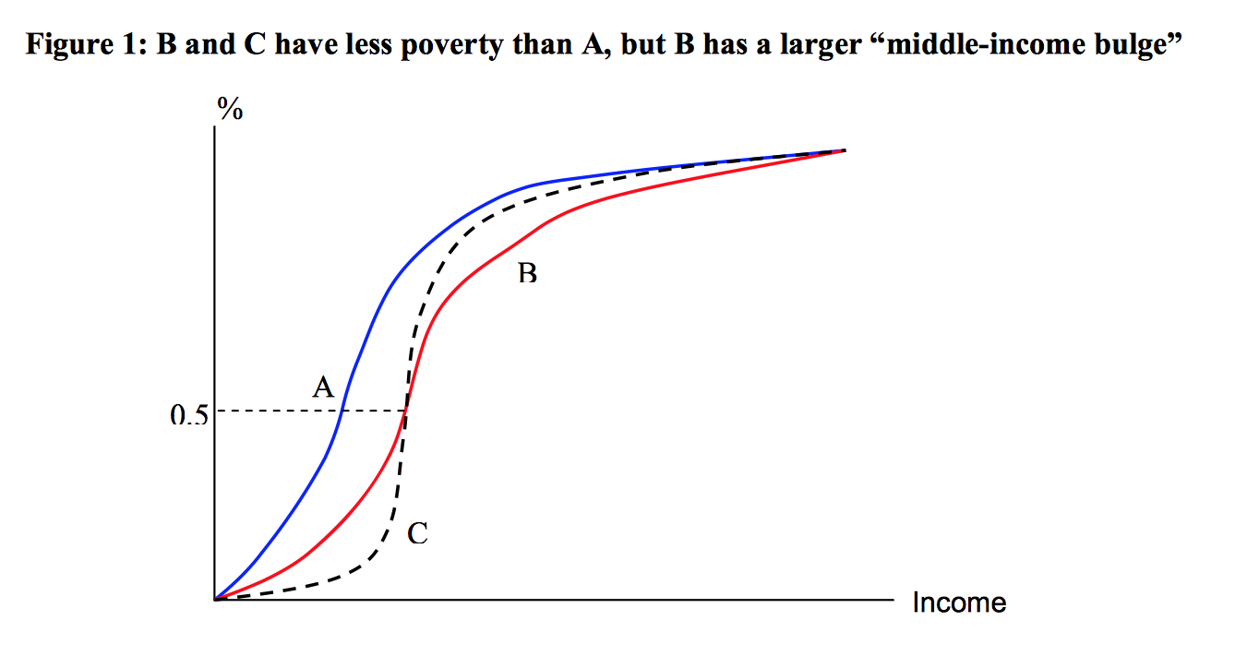
Introduction
Poverty is also unambiguously lower for C than A, but C has a bigger bulge in the middle of the distribution, in that the density is appreciably higher at the median than for B and this holds in a wide interval around the median.
In terms of the prospects of
falling below relatively low poverty
lines, distribution C has more people
vulnerable to an aggregate economic
contraction than B.

Slide 4
Measuring the middle class
Typically, being “middle class” is defined as having an income within some interval that includes the median. An influential early paper by Thurow (1987) focused on the interval from 75% to 125% of the median.
Birdsall et al. (2000) defined the middle class as those with incomes between 75% and 125% of the median in each country.
Milanovic and Yitzhaki (2002) defined the middle class as those living between the mean incomes of Brazil and Italy.
Banerjee and Duflo (2008) identified the “middle class” in developing countries as those living between $2 and $10 a day.
Notes:
The definition proposed here is close to the Banerjee-Duflo definition, but I try to give the bounds more meaning. The developing world’s middle class is defined as those who are not deemed “poor” by the standards of developing countries but are still poor by the standards of rich countries. For the lower bound I will use the median poverty line in poverty lines for 70 national poverty lines, drawn from in-country poverty measurement studies by the World Bank and national governments; the data on national poverty lines are described in Ravallion et al. (2008).
Each of the national poverty lines in this sample is designed to attain recommended food-energy requirements with (socially-specific) allowances for basic nonfood needs. The median of these national lines is $2.00 per day at 2005 purchasing power parity (PPP) using the PPPs for household consumption from the 2005 International Comparison Program (World Bank, 2008; www.worldbank.org/data/icp). As we will see, this is only slightly below the median for the population of the developing world as a whole.

Slide 5
Measuring the middle class
The author purposes a new way to define middle class, that is, the developing world’s middle class is defined as those who are not deemed “poor” by the standards of developing countries but are still poor by the standards of rich countries.
Lower bound: the median poverty line in poverty lines for 70 national poverty lines, drawn from in-country poverty measurement studies by the World Bank and national governments; the data on national poverty lines are described in Ravallion et al. (2008).
Developing world’s upper middle classthe lower bound is $9 a day.

Slide 6
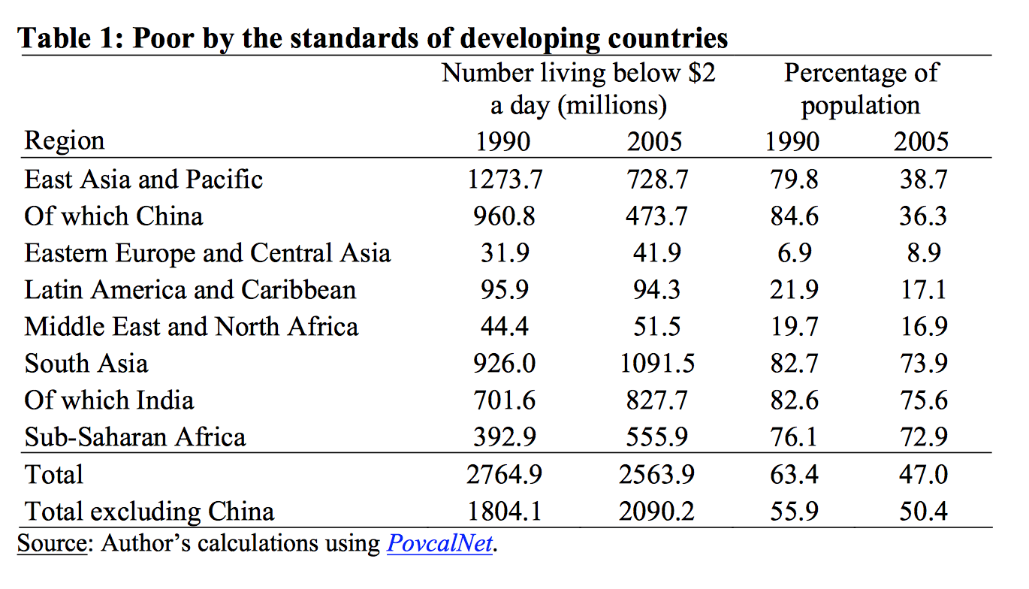
Evidence on the developing world’s expanding middle class
Table 1 reproduces the Chen-Ravallion estimates
of the poverty rate for the $2 a day line.
Ft (z) is the poverty rate (often called the
“headcount index”) at date t=(19)90 and (20)05 for
the poverty line z in $’s per day at 2005 PPP. So
Table 1 gives F90 (2) and F05 (2) by region and in
the aggregate for the developing world.

Slide 7
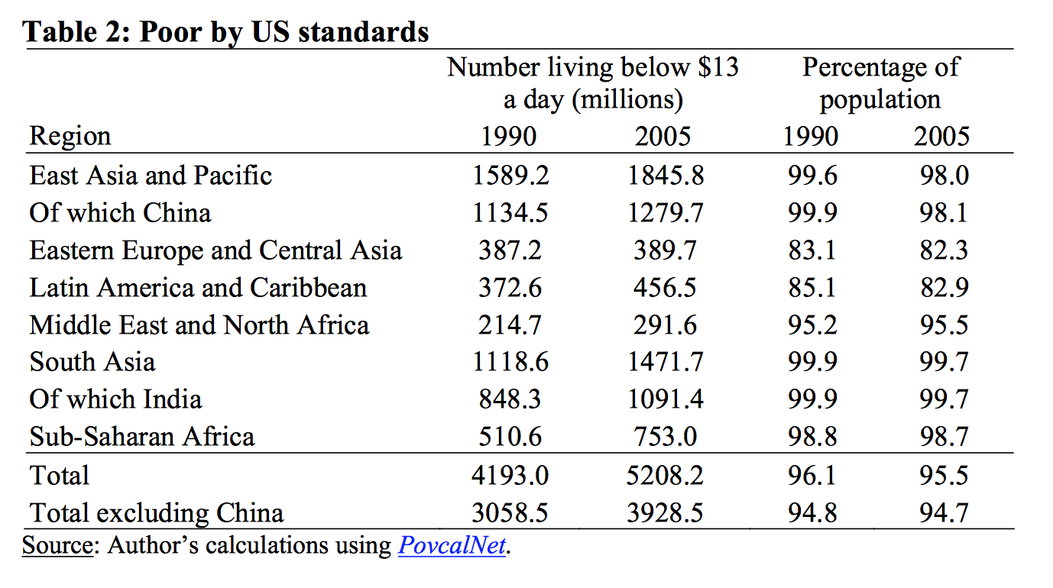
Evidence on the developing world’s expanding middle class
Using the $13 a day line, the author finds that
over 95% of the developing world in 2005 is
deemed to be poor by US standards.
Ft (13) has fallen very little over time—by only
one half of a percentage point.

Slide 8
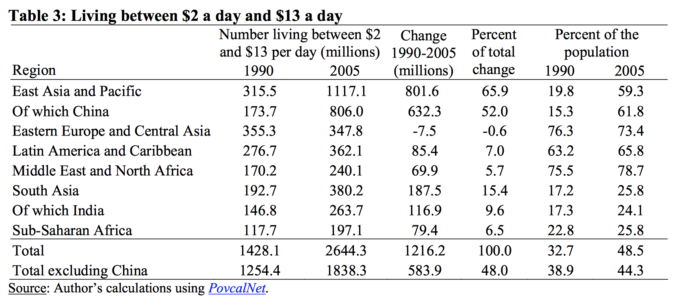
Evidence on the developing world’s expanding middle class
( Ft (13) − Ft (2) increased from 33% in 1990
To 49% in 2005, or from 1.4 billion to 2.6 billion
people.
China accounts for half of this increase and
East Asia as a whole for two-thirds.
In 1990, only 15% of the Chinese population
lived above $2 but below $13; by 2005 the
proportion had risen to 62%. Though not as
large (absolutely or proportionately) as for
China, India saw an extra 117 million people
join this middle-income group.
All regions of the developing world saw an increase in Ft (13) − Ft (2) except Eastern
Europe and Central Asia where the number fell slightly over the period.

Slide 9
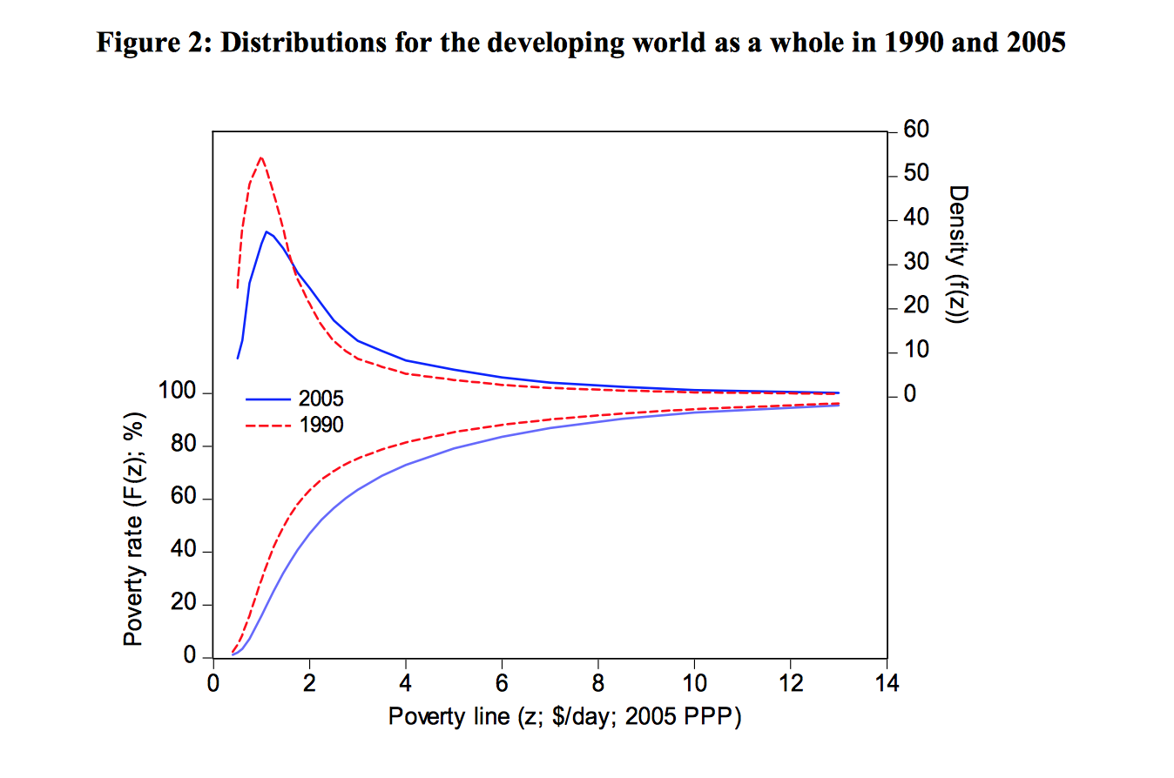
Evidence on the developing world’s expanding middle class
While a reduction in poverty is indicated for
all lines, it is clear that this has not been a
simple rightward displacement of the density
function.
The mode has remained almost unchanged over
this period, at around $1.00 per day. The mean
and median have increased, from $3.14 and $3.94
per day for 1990 and 2005 respectively for the
mean, while the medians were $1.47 and $2.13.
Instead of a simple rightward displacement, we
have seen a marked “bunching up” due to a shift
in densities from below the $2 a day line to just
above it, with the bulk of the gain in the interval
$2 to $6 a day. The bulge in 2005 is mostly above the median.
Notes:
The empirical estimates of the
CDF’s and densities for 1990 and 2005 are given in Figure 2.13 While a reduction in poverty is indicated for all lines, it is clear that this has not been a simple rightward displacement of the density function. Indeed, the mode has remained almost unchanged over this period, at around $1.00 per day. The mean and median have increased, from $3.14 and $3.94 per day for 1990 and 2005 respectively for the mean, while the medians were $1.47 and $2.13. Instead of a simple rightward displacement, we have seen a marked “bunching up” due to a shift in densities from below the $2 a day line to just above it, with the bulk of the gain in the interval $2 to $6 a day. Thebulgein2005ismostlyabovethemedian.

Slide 10
Evidence on the developing world’s expanding middle class
It is clear that very little of the expansion in the developing world’s middle class was due to its “upper middle class,” namely those living above the highest poverty line found amongst developing countries, but still below the US line.
Over 1990-2005, the estimated value of F (13) − F (9) rose from 3.1% to 4.3%, or from 139 million to 233 million.
Of the extra 1.2 tt billion people who joined the middle class, only 95 million made it to this upper stratum.

Slide 11
Bulging middles within developing countries?
For each of almost 100 developing countries, it is possible to assess whether there has been a bulging middle over time.
The author uses both the changes in the population share between $2 and $13 a day and the changes in the FW index of concentration around the median.
di (xit ) ≡ (xit − xit−τi ) /τi (the absolute and proportionate annualized differences for the variable x)
gi (xit ) ≡ (ln xit − ln xit−τi ) /τi (for country i looking back from date t over a time interval of length τi)
gi (.) is simply the average growth rate of x over the period, so gi (μit ) is the rate of growth in the mean, μit.
Fit (z) denotes the CDF for country i at date t, giving the proportion of the population living in households with consumption or income not exceeding z in $’s per day at 2005 PPP.

Slide 12
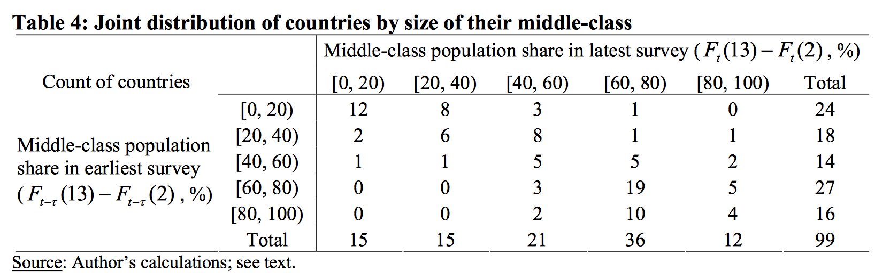
Bulging middles within developing countries?
Table 4 gives a 5x5 contingency table that summarizes the joint distribution across the two survey rounds of the
sizes of the middle class across countries. A strong positive correlation is evident.
The expanding middle-class amongst those countries that started with middle-class shares less than 40%.
There is a marked fall in the size of the middle-class in some countries that started with a large share (over 80%)
of the population in the $2-$13 interval; some of this is undoubtedly measurement error.

Slide 13
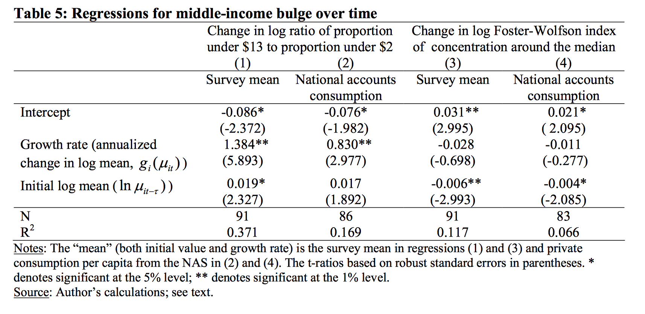
Bulging middles within developing countries?
The regression line has a slope significantly less than unity; the regression it it−τ coefficient is 0.704 with a robust standard error of 0.050, and the intercept is 18.776% (s.e.=3.149).
The share of the population living between $2 and $13 a day rose in 64 out of the 99 countries.
The mean d ( A ) i it was 0.22 percentage points per year and the median was 0.45 percentage points per
year. The mean gi (Rit ) is 0.024 (and the median is 0.011) or a growth rate of about 2% per year.

Slide 14
Does a larger middle class help assure pro-poor growth?
Countries with a larger middle-class tended to attain higher subsequent rates of poverty reduction from a given rate of growth.
Poorer countries tend to experience lower proportionate impacts on their poverty measures from any given rate of growth
Countries with high current poverty rates have tended to experience less middle-income bulge.
Countries that have enjoyed the largest expansions in their middle class that will be most vulnerable to aggregate economic downturns in the wake of the crisis.
It is not the proportionate impact on poverty that one is most concerned with in this context, but the absolute impact, for that is what matters to the number of people experiencing extreme poverty.

Slide 15
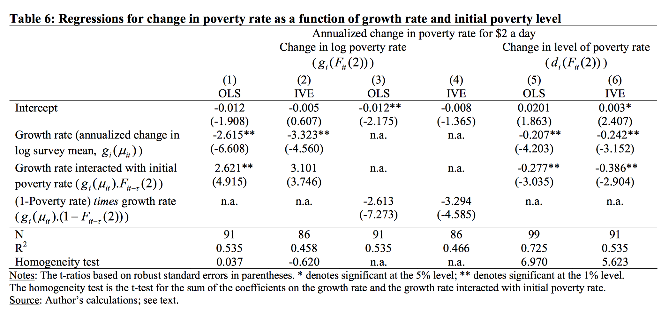
Does a larger middle class help assure pro-poor growth?
Table 6 confirm that the (absolute) growth elasticity of poverty reduction tends to be lower in poorer countries.
In terms of the absolute impacts on poverty, higher growth tends to be more poverty reducing in poorer
countries, not less.
The poorer the country, the greater the absolute impact on poverty that is to be expected from any given rate
of aggregate economic contraction.

Slide 16
Conclusion
A large proportion of the 1.2 billion people who entered the middle classes according to this standard during 1990-2002 period (four-fifths coming from Asia and half from China) have remained close to poverty levels.
The global growth of the middle classes cannot therefore simply be interpreted as a linear growth in wealth: although poverty has been successfully reduced in recent decades, this does not imply that poverty has vanished.
This middle-class advantage is mainly due to initial differences in the incidence of extreme poverty. Starting out with a high poverty rate makes it harder to achieve a given proportionate impact on the poverty count through economic growth.
Poor people living in countries with smaller middle classes will be more exposed to aggregate economic contractions.
Large segments of this new ‘middle class’ still live dangerously close to the poverty lines. In the event of economic downturn, they are just as likely to fall back into poverty.

